Slide 1
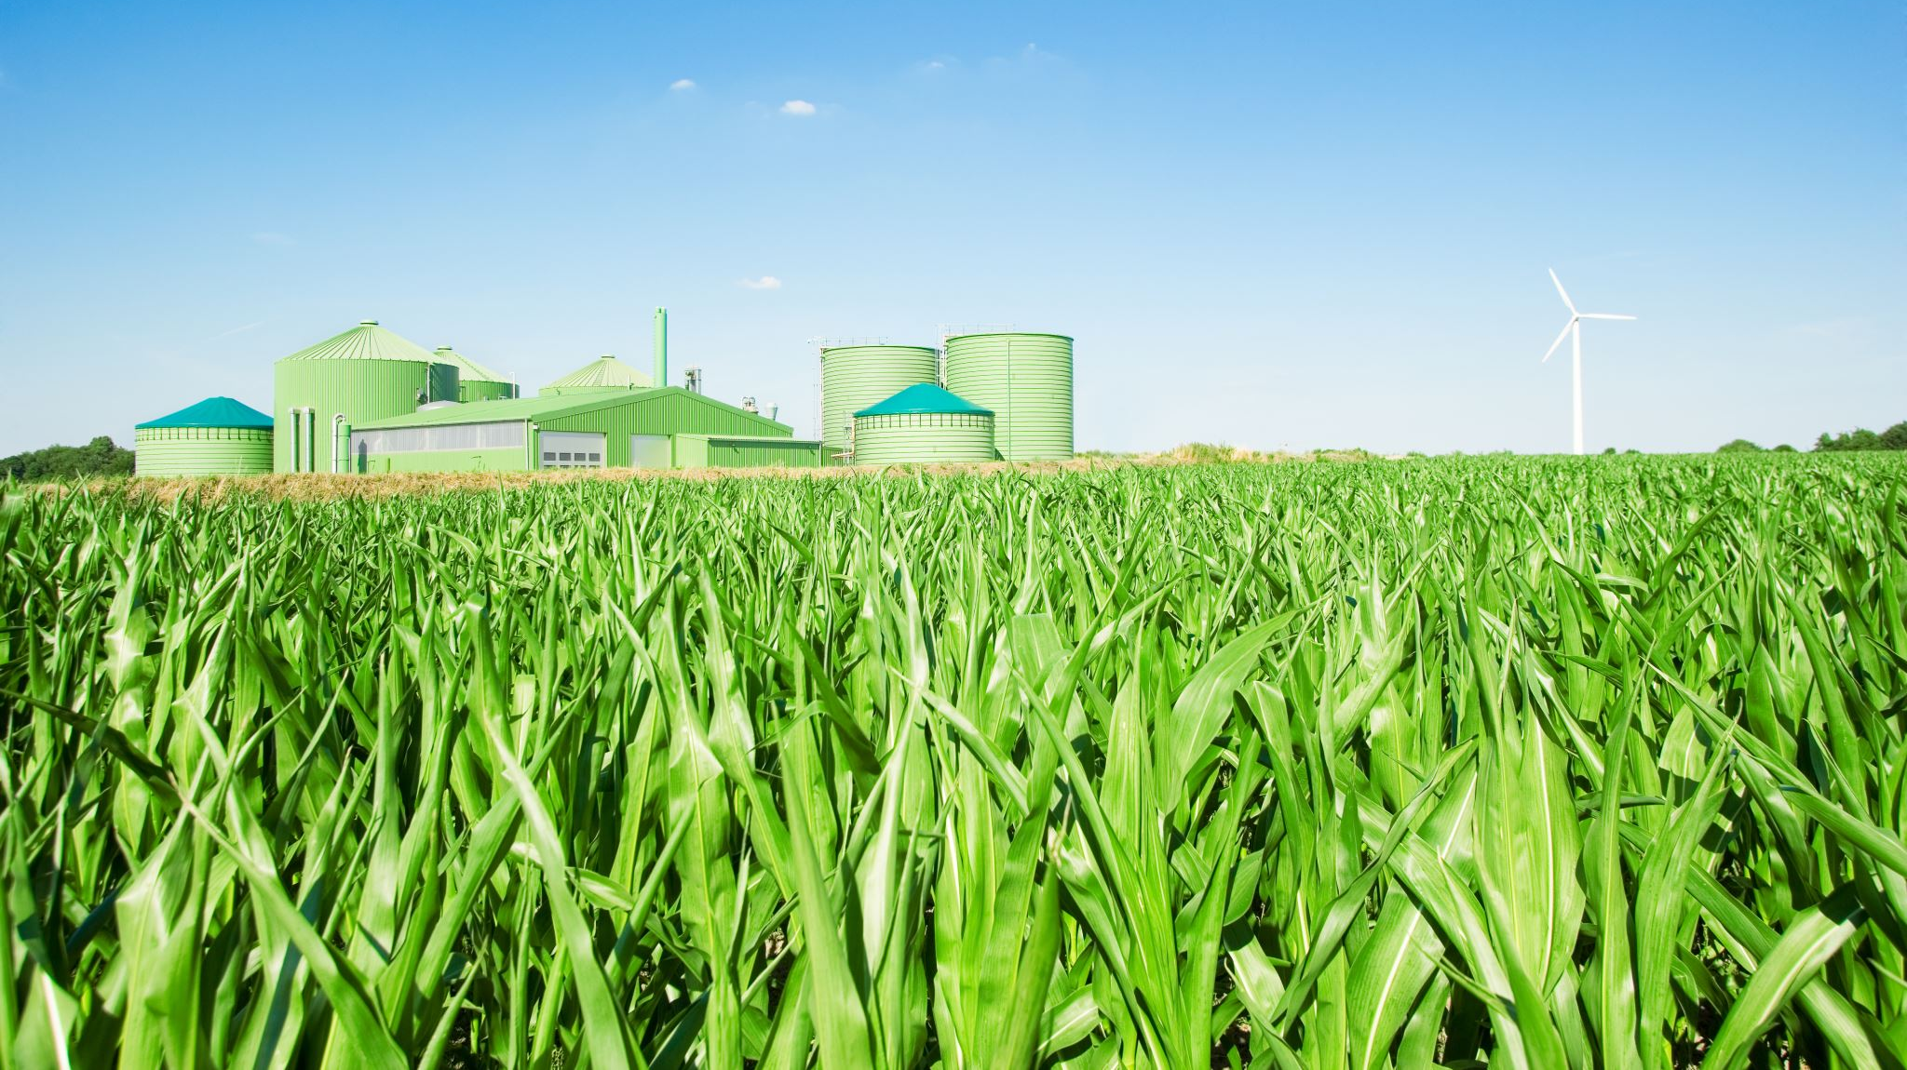
Correlated Losses in Federal Crop Insurance
Jonathon Siegle, Victor Gardner
Github: https://github.com/SiegleJ798/UsdaRma

Slide 2
Project Objective
The geographic spread of weather shocks and pests lead to systemic, correlated crop losses.
Understanding the correlations between these losses aids both the firms balancing a portfolio of farms, but also the USDA’s design of subsidized crop insurance policies.
This project explores the capacity to model average crop losses as a function of the losses experienced by other crops, relative to local norms
The local, annual data on crop losses was provided by the USDA Risk Management Agency’s Summary of Business Files

Slide 3
Exploration: Binary Tree

Slide 4
Binary Tree Results

Slide 5
Exploration: LASSO
For each target Crop-Coverage Level, the losses in each county-year was estimated to be a function of the losses for the other Crop-Coverage Level groups in the same county-year
Ln ( Loss Ratio_{i} ) = A*Ln( Loss Ratio_{-i} ) + B*1(Missing_{-i} ) + State FE
The ability for one crop to signal another’s demise was judged on its coefficient’s survival against increasing alpha as well as its end average coefficient.
For comparison, mean squared errors are contrasted against a regression on only State fixed effects
Ln ( Loss Ratio_{i} ) = State FE

Slide 6
How many Kfolds preserved each Ln( Loss Ratio_{-i} ) ( of 5 Kfolds, a=0.01)
Crop | Coverage Level | Wheat |  | Cotton |  | Corn |  | Grain Sorghum |  | Soybeans |  | Pasture | Barley
 |  | Buy Up | Catastrophic | Buy Up | Catastrophic | Buy Up | Catastrophic | Buy Up | Catastrophic | Buy Up | Catastrophic | Buy Up | Buy Up | Catastrophic
Wheat | Buy Up |  | 5 | 5 | 0 | 5 | 0 | 5 | 0 | 5 | 0 | 0 | 5 | 5
Wheat | Catastrophic | 5 |  | 0 | 0 | 2 | 5 | 0 | 5 | 4 | 5 | 0 | 0 | 5
Cotton | Buy Up | 5 | 0 |  | 5 | 5 | 4 | 5 | 3 | 5 | 5 | 5 | 0 | 0
Cotton | Catastrophic | 4 | 5 | 5 |  | 5 | 0 | 2 | 5 | 3 | 2 | 0 | 0 | 0
Corn | Buy Up | 5 | 0 | 5 | 0 |  | 5 | 5 | 5 | 5 | 5 | 5 | 4 | 0
Corn | Catastrophic | 0 | 5 | 0 | 0 | 5 |  | 0 | 1 | 5 | 5 | 0 | 0 | 0
Grain Sorghum | Buy Up | 5 | 4 | 5 | 0 | 5 | 5 |  | 5 | 5 | 4 | 4 | 0 | 0
Grain Sorghum | Catastrophic | 4 | 5 | 0 | 5 | 3 | 5 | 5 |  | 1 | 5 | 1 | 1 | 0
Soybeans | Buy Up | 5 | 0 | 5 | 2 | 5 | 4 | 5 | 0 |  | 5 | 0 | 5 | 2
Soybeans | Catastrophic | 5 | 5 | 0 | 0 | 4 | 5 | 0 | 5 | 5 |  | 0 | 2 | 0
Pasture | Buy Up | 2 | 5 | 5 | 4 | 5 | 1 | 5 | 0 | 5 | 5 |  | 5 | 4
Barley | Buy Up | 5 | 5 | 0 | 0 | 5 | 0 | 2 | 0 | 5 | 3 | 0 |  | 5
Barley | Catastrophic | 5 | 5 | 0 | 0 | 5 | 4 | 3 | 2 | 5 | 5 | 5 | 5

Slide 7
Average Coefficients
Crop | Coverage Level | Wheat |  | Cotton |  | Corn |  | Grain Sorghum |  | Soybeans |  | Pasture | Barley
 |  | Buy Up | Catastrophic | Buy Up | Catastrophic | Buy Up | Catastrophic | Buy Up | Catastrophic | Buy Up | Catastrophic | Buy Up | Buy Up | Catastrophic
Wheat | Buy Up |  | 0.354 | 0.017 | 0.000 | 0.055 | 0.000 | 0.068 | 0.000 | 0.066 | 0.000 | 0.000 | 0.209 | 0.017
 | Catastrophic | 0.462 |  | 0.000 | 0.000 | -0.001 | 0.038 | 0.000 | 0.021 | -0.008 | 0.070 | 0.000 | 0.000 | 0.039
Cotton | Buy Up | 0.056 | 0.000 |  | 0.292 | 0.157 | 0.008 | 0.132 | 0.012 | 0.134 | 0.031 | 0.058 | 0.000 | 0.000
 | Catastrophic | 0.005 | 0.024 | 0.379 |  | -0.018 | 0.000 | -0.012 | 0.042 | 0.011 | 0.010 | 0.000 | 0.000 | 0.000
Corn | Buy Up | 0.038 | 0.000 | 0.120 | 0.000 |  | 0.272 | 0.166 | 0.047 | 0.365 | 0.019 | 0.088 | 0.011 | 0.000
 | Catastrophic | 0.000 | 0.011 | 0.000 | 0.000 | 0.314 |  | 0.000 | 0.009 | -0.038 | 0.157 | 0.000 | 0.000 | 0.000
Grain Sorghum | Buy Up | 0.103 | -0.004 | 0.098 | 0.000 | 0.180 | 0.032 |  | 0.301 | 0.116 | 0.012 | 0.014 | 0.000 | 0.000
 | Catastrophic | 0.026 | 0.065 | 0.000 | 0.023 | 0.014 | 0.116 | 0.442 |  | -0.002 | 0.049 | -0.014 | -0.010 | 0.000
Soybeans | Buy Up | 0.048 | 0.000 | 0.090 | 0.007 | 0.447 | -0.015 | 0.113 | 0.000 |  | 0.182 | 0.000 | 0.029 | 0.003
 | Catastrophic | 0.011 | 0.043 | 0.000 | 0.000 | -0.059 | 0.379 | 0.000 | 0.016 | 0.230 |  | 0.000 | 0.004 | 0.000
Pasture | Buy Up | -0.013 | -0.008 | 0.062 | 0.005 | 0.211 | 0.018 | 0.073 | 0.000 | 0.119 | -0.006 |  | 0.029 | 0.025
Barley | Buy Up | 0.350 | 0.016 | 0.000 | 0.000 | 0.035 | 0.000 | 0.003 | 0.000 | 0.028 | 0.007 | 0.000 |  | 0.196
 | Catastrophic | 0.023 | 0.143 | 0.000 | 0.000 | 0.023 | 0.074 | 0.023 | 0.012 | 0.021 | 0.062 | 0.045 | 0.328

Slide 8
Model Performances and Conclusion
For most runs, the average mse of the LASSO model is lower than that of the baseline model for alphas of 0.01 and 0.001
Diff is typically 0.8 v.s. 1.0
However, this improvement is small and dependent on the Crop-Coverage level used as the dependent variable.
Aside from a few notable combinations, this exercise casts doubt on useful crop shock correlations after controlling for differences in average loss ratio by State

